Slide 1
Hi I'm xam!
Welcome to xam land! This is my house !
Your mission is to destroy all 3 kazes!
Click on my head!

Slide 2


Slide 3


Slide 6
Teleporter!
a
s
s
d
f

Slide 7
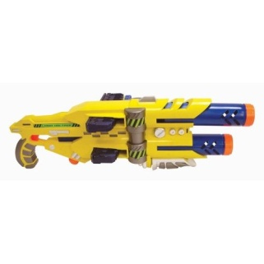


Slide 8
Do not enter!

Slide 9
Elevator!

Slide 10
Elevator!
Muhahaha I am apartment kaz!

Slide 11
Elevator!
Password to first teleporter!
F S
And Invisible button in bottom right corner!

Slide 14
Teleporter!

Slide 15
Trap door

Slide 16



Slide 17
One way!

Slide 18

Do not enter!

Slide 22
Do not touch!

Slide 25
Trap door!

Slide 26
Muhahahaha!
I am factory kaz!

Slide 27
Trap door!

Slide 34
i7
e9

Slide 37
One way!

Slide 48
One way!
One way!

Slide 49
One way!
One way!

Slide 50
x

Slide 51
One way!
One way!

Slide 52
One way!
One way!

Slide 53
One way!
Not one way!
One way!

Slide 54
Do not enter!

Slide 55


Slide 56

Muhahahaha I am Stone kazez robot!

Slide 60


Slide 61
Trap door

Slide 64
McDonalds!
Do not enter!

Slide 65
Mom didn’t have time today so we made you this baked apple pie!
Click here to play golf!

Slide 66


Slide 70
gold!
1
2
3

Slide 71
You lost!
Click here to end!

Slide 72
You win!
Click here to end!
par

Slide 73
You win!
Click here to end!
1

Slide 74
You win!
Click here to end!
2

Slide 75
You win!
Click here to end!
3

Slide 76
You win!
Click here to end!
Gold!!!

Slide 77
Mom didn’t have time today so we made you this baked apple pie!
Click here to play golf!

Slide 78
McDonalds!

Slide 80
Do not enter!

Slide 81
I am kygam and I have very powerful magyk!

Slide 83
I am xam! You are now entering Kaz land! In kaz land watch out for ghosts and kaz army bots and other things like that! Also this is a checkpoint if you die at a point farther than this you will start back from here!
Xam land!
Kaz land!

Slide 84


Slide 85


Slide 88

Kaz!

Slide 89
Muhahahaha!
I am ghost kazez robot!

Slide 90
Mt. Kaz!

Slide 92
Extreme heat
Highly eruptive!
Extreme heat
Highly eruptive!
Extreme heat
Highly eruptive!
Extreme heat
Highly eruptive!
Extreme heat
Highly eruptive!

Slide 93
Extreme heat
Highly eruptive!
Extreme heat
Highly eruptive!
Extreme heat
Highly eruptive!
Extreme heat
Highly eruptive!
Extreme heat
Highly eruptive!

Slide 97
Muhahahahahahahahahahahahahaha!
I am ultimate kazez robot!

Slide 98
Muhahahahahahahahahahahahahahahahahahahahahahaha!
Stage 2!

Slide 101
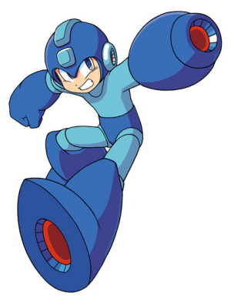
I am xam! This is a checkpoint if you die at a point farther than this you will start back from here!and you might need this picture!

Slide 102
Blinded!
Eae eaem keae? Eae eaem thee geaerdeaen eaef keaeseaes keaesteael?
Theaet peaecteaear eaes teae ceael?

Slide 111
Muhahahaha!
I am X kazez robot!

Slide 114

Note from xam!
This is a checkpoint!
You know what that means!
Trap door!

Slide 115
Muhahahahahahahahahahahahahahahahahaha!!!!!!!!!!!!!!!!!
I am castle kaz!!!!!!!!!!!

Slide 118
I am xam!
You have won the kaz destructer award!

Slide 119

…Your very own
Takanawa!
Your prize is…
Credits!
Xam! Group 9!
Apartment kaz! Group 14!
Factory kaz! Group 20!
Castle kaz! Group 20!
Maker Cool dude!
Slides 1-118!

Slide 120
End (press escape to leave)
Credits!
Xam! Group 9!
Apartment kaz! Group 14!
Factory kaz! Group 20!
Castle kaz! Group 20!
Slides 1-120!

